Slide 1
Regularized Harmonic Surface Deformation
Computational Shape Modeling
Instructor : Aditya Tatu
201401414
Maharshi Vyas

Slide 2
Presentation Contents
Artifacts in Deformation
Harmonic Surface Deformation - Intuition and Discretization
Energy Regularization by smoothing - Intuition and Discretization
Regularized Harmonic Surface Deformation - Discretization
Implementation Details
Results

Slide 3
Artifacts in Deformation

Slide 4
Mostly Seen Artifacts
Distortion of Local Geometry
Topology preservation failure
Degenerate triangles
Intruding or protruding triangles or elements
Volume Loss

Slide 5
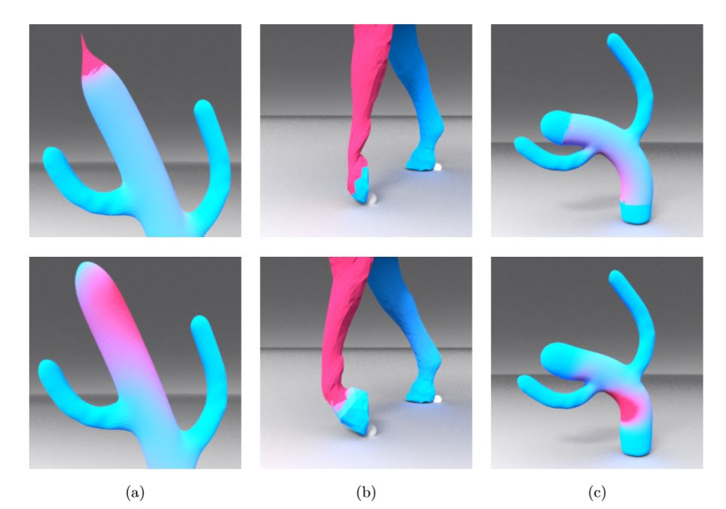
Protruding Elements
Volume Loss
Local Shape Distortion
Need of regularization?

Slide 6
Harmonic Surface Deformation
Intuition
Discretization

Slide 7

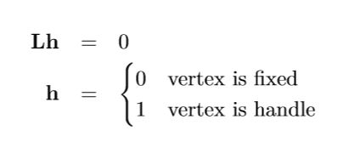
Harmonic Guidance for Surface Deformation - Intuition
Linear Method - Deformation by solving a linear system
Use of Gradient Manipulation - Preserves differential properties
Harmonic Fields are used to guide gradients
Harmonic field - h is defined by:

Slide 8
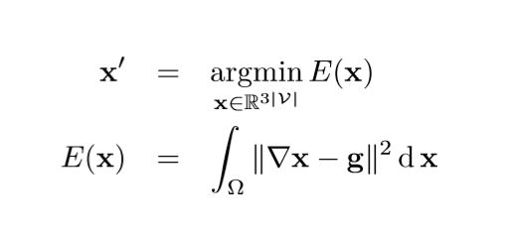
Formulation
Deformation Gradient guidance field is g.
Guidance field g is derived using harmonic fields.

Slide 9
Transformation Propagation process
Transformation propagation using geodesic or euclidean distances - Generally
Transformation Propagation using harmonic field
Transformations decomposed in translation, rotation, scaling, shearing matrices.
Harmonic field value used to interpolate between fixed and handle points for each matrix.
Solving the final transformation for each vertex (By multiplying individual matrices)

Slide 10

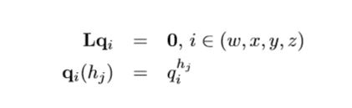


Transformation Propagation Process
For e.g. Harmonic field for rotation
For handle vertices h, Using Quaternions for rotation:-
Deriving matrices from harmonic fields of each rotation, scaling, transformation

Slide 11
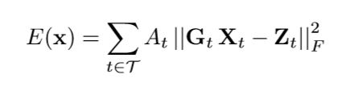
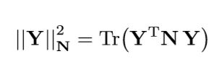
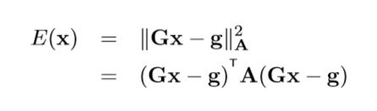
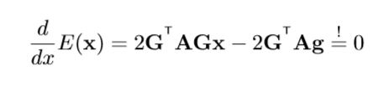

Discretization
Defining a matrix norm as

Slide 12
Energy Regularization
Intuition
Discretization

Slide 13
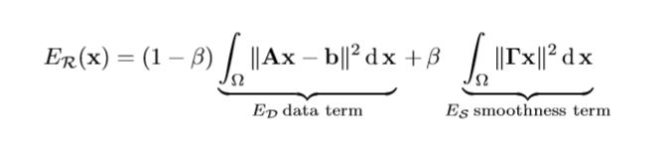
Tikhonov Regularization
Choices for smoothness term:-
norm(x)
norm(grad(x))
norm(Lx)

Slide 14
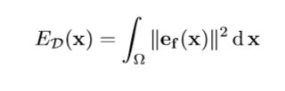
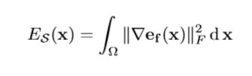
Regularization Proposed by Esturo[4]
Smoothness term Tikhonov - Not problem specific , Data term independent
Large local energy variations around artifacts
By penalizing variations , Proposed formulation will be:

Slide 15
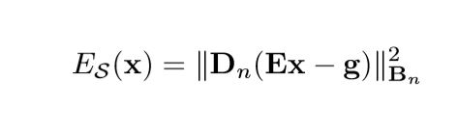
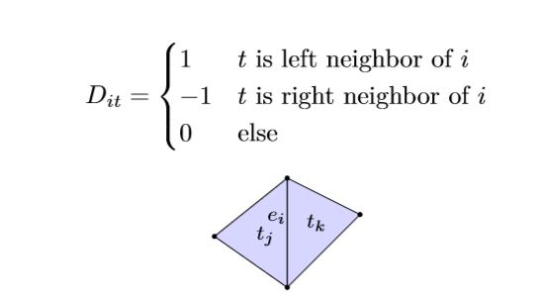

Discretization - 2D meshes
Denote smoothness term as linear operator multiplied by energy function.

Slide 16
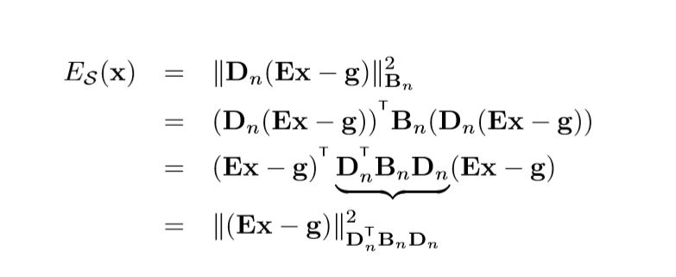
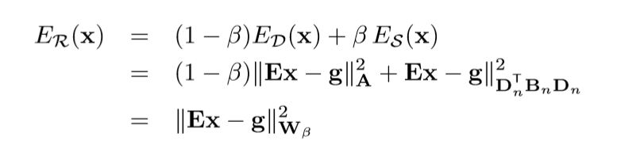

Discretization

Slide 17
Regularized Harmonic Surface Deformation

Slide 18

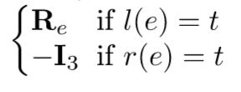

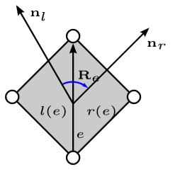
Discretization
For 3D meshes, the D operator should be changed.

Slide 19
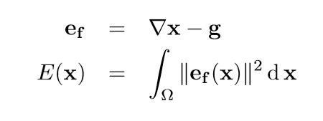
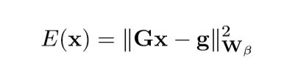
Apply Regularization
Harmonic Deformation:
After Regularization:

Slide 20
Implementation Details

Slide 21
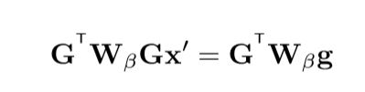
Implementation
From previous discrete equation, on solving:
Deriving corresponding metrices from mesh,
Finding harmonic gradient guidance g
And solving abouve linear system

Slide 22
Results

Slide 23
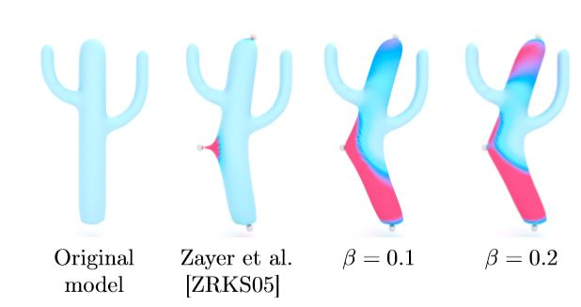
Results

Slide 24
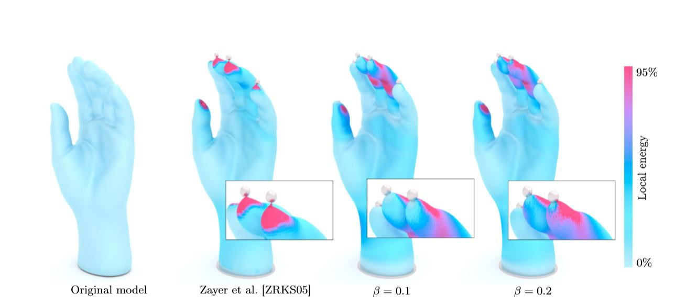
Results

Slide 25
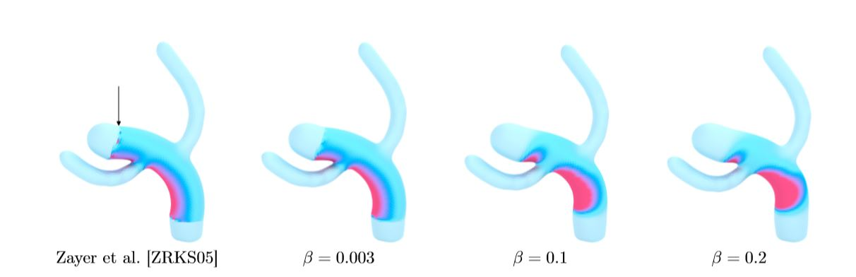
Results

Slide 26
References
[1] HarmonicGuidanceforSurfaceDeformation
[2] Smoothed Quadratic Energies on Meshes , Esturo

